Slide 1

Data Tidying and Cleaning
Preparing data for knowledge extraction
Yordan Darakchiev
Technical Trainer
iordan93@gmail.com

Slide 2
sli.do #Data-Science

Slide 3
Table of Contents
Messy and tidy data
Tidying up messy data
Operations on datasets
Cleaning data
Validation
Transformation
Error correction
Features
Data tidying and cleaning as a process

Slide 4
Data Tidying
Arranging data in a meaningful manner

Slide 5
Tidy Data
Most important rules when creating (or using) datasets
Columns – attributes (features, variables)
Rows – observations
Cells – values (one observation of one feature)
All other data is called messy data
Empirical rule for testing whether a dataset is tidy
Adding one more observation should create one new row
No new columns
No multiple rows
No partial rows, no changes to other rows
pandas allows us to read, tidy up and transform datasets
Data modelling requires a tidy and clean dataset in order to work well (garbage in – garbage out)

Slide 6
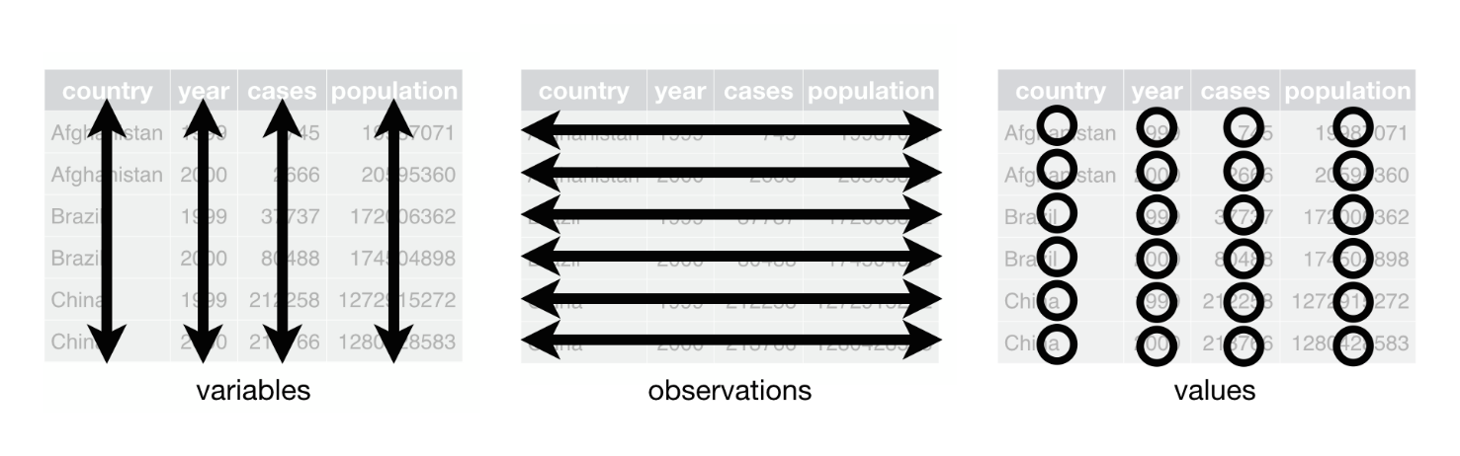
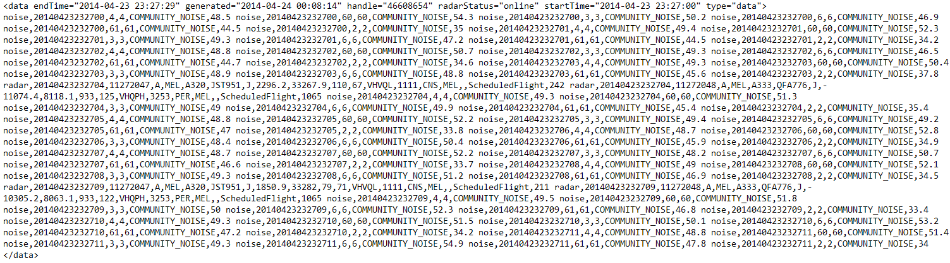
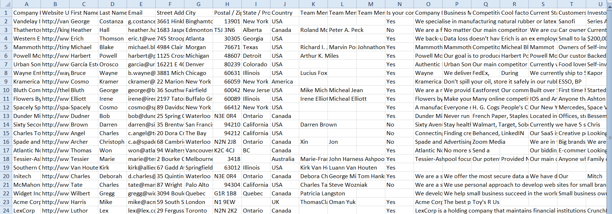
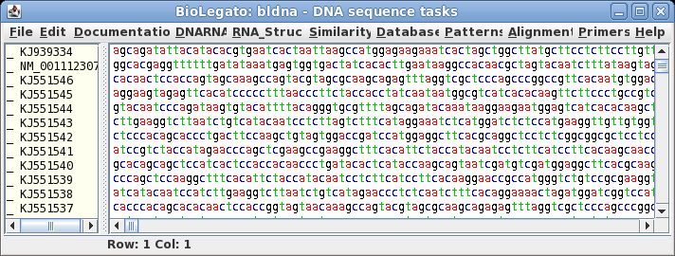
Messy Data
What we want
What we get instead

Slide 7
Tidy and Messy Data
A very good paper on tidy data
Example: several datasets
Same information, different ease of use
country year cases population
1 Afghanistan 1999 745 19987071
2 Afghanistan 2000 2666 20595360
3 Brazil 1999 37737 172006362
4 Brazil 2000 80488 174504898
5 China 1999 212258 1272915272
6 China 2000 213766 1280428583
Tidy dataset
country year key value
1 Afghanistan 1999 cases 745
2 Afghanistan 1999 population 19987071
3 Afghanistan 2000 cases 2666
4 Afghanistan 2000 population 20595360
5 Brazil 1999 cases 37737
6 Brazil 1999 population 172006362
7 Brazil 2000 cases 80488
8 Brazil 2000 population 174504898
9 China 1999 cases 212258
10 China 1999 population 1272915272
11 China 2000 cases 213766
12 China 2000 population 1280428583
country year rate
1 Afghanistan 1999 745/19987071
2 Afghanistan 2000 2666/20595360
3 Brazil 1999 37737/172006362
4 Brazil 2000 80488/174504898
5 China 1999 212258/1272915272
6 China 2000 213766/1280428583

Slide 8
Messy to Tidy Data
The table header contains values
Identify the variables and distribute (unpivot) the values
Read the pew.csv dataset
Distribution of income by religion
Show the first 5 values (use the head() function)
Also see the number of variables and observations (shape)
This will also ensure that you've read the dataset correctly
Variables: religion, income, frequency
Transform the dataset to make it tidy (docs)
pew = pd.read_csv("pew.csv")
pew_tidy = pd.melt(pew,
id_vars = ["religion"], # Identifier variables (all others are "unpivoted")
var_name = "income", # Variable
value_name = "frequency") # Value

Slide 9
Messy to Tidy Data (2)
Multiple variables stored in one column
Identify and split the variables into separate columns
Read the tb.csv dataset
Tuberculosis cases
m04, m514, m1524, etc. contain two variables (gender and age)
male, 0-4 years old; male, 5-14 years old, etc.
There's also a problem with missing values (NaN)
Tidying process
First, melt all columns (they are values and should not be)
Next, split the column names and extract the gender and age information
Add the new info to the dataset
Remove all missing values

Slide 10
Messy to Tidy Data (3)
tb = pd.read_csv("tb.csv")
# Melt the values
tb = pd.melt(tb, id_vars = ["iso2","year"], value_name = "cases", var_name = "sex_and_age")
# Separate the columns and merge back
parts = tb["sex_and_age"].str.extract("(\D)(\d+)(\d{2})", expand = True)
parts.columns = ["sex", "age_lower", "age_upper"]
parts["age"] = parts["age_lower"] + "-" + parts["age_upper"]
tb = pd.concat([tb, parts], axis = 1)
# Remove missing values and sort them
tb = tb.drop(["sex_and_age", "age_lower", "age_upper"], axis = 1)
tb = tb.dropna()
tb = tb.sort_values(by = ["iso2", "year", "sex", "age", "cases"])
# The index is now wrong, reindex to make it better
tb = tb.reset_index()
del tb["index"]

Slide 11
Messy to Tidy Data (4)
Variables are stored in both rows and columns
Identify and split the variables
Read the weather.csv dataset
Daily weather records in Mexico in 2010
d1, d2, etc. are the days of a month; also tmin and tmax should be columns
Make a new column with the date: [date, tmin, tmax]
Tidying process
Melt all days
Create days based on date, month and year
Pivot the tmin and tmax columns

Slide 12
Messy to Tidy Data (5)
temp_data = pd.read_csv("weather.csv")
temp_data = pd.melt(temp_data, id_vars = ["id", "year", "month", "element"], var_name = "day")
temp_data["day"] = temp_data["day"].str.extract("(\d+)", expand = True).astype(np.int64)
# Remove missing / invalid days (e.g. 31st April) and dates with no records
temp_data = temp_data.dropna()
temp_data["date"] = pd.to_datetime(temp_data[["year", "month", "day"]])
temp_data = temp_data.drop(["year", "month", "day"], axis = 1)
# Pivot the elements back to their own columns
temp_data = temp_data.pivot_table(index = ["id", "date"], columns = "element", values = "value")
# Pivoting returns a multi-indexed element, go back to a flat DataFrame
temp_data.reset_index(inplace = True)
temp_data.columns.name = ""

Slide 13
Messy to Tidy Data (6)
One type in multiple tables
Merge the tables into one
Read all tables, add the new columns
Often the filename should be in its own column (if it's important)
Melt and tidy if necessary
Multiple types in one table
Split into more tables
If necessary, introduce relations (similar to a relational database)
Each table should be responsible for one type of measurement
* Read the billboard.csv dataset and apply those transformations

Slide 14
Operations on Datasets
Basic tools to get started working with messy data

Slide 15
Subsetting Rows
Selecting only some rows (aka selection)
First / last n records (observations)
Random n records
Smallest / largest n records in a given column
Subsetting by a Boolean expression (predicate)
Returns only rows where the expression returns True
temp_data.head(10)
temp_data.tail() # 5 by default
temp_data.sample(n = 10)
temp_data.sample() # 1 random record by default
temp_data.nsmallest(3, "tmax")
temp_data.nlargest(3, "tmax")
temp_data[temp_data.tmax > 30]

Slide 16
Subsetting Columns
Selecting only some columns (aka projection)
Single column (returns a Series object)
More than one column (returns a DataFrame object)
Combining filters
A note on Boolean expressions
"and", "or", "not" are &, |, ~
Always put parentheses around the individual expressions
temp_data["tmax"]
temp_data.tmax # Possible in most cases
temp_data[["tmin", "tmax"]]
temp_data[temp_data.date > "2010-08-01"][["date", "tmax"]]
temp_data.loc[temp_data.date > "2010-08-01", ["date", "tmax"]]
temp_data[(temp_data.date > "2010-08-01") & (temp_data.date < "2010-09-01")]

Slide 17
Summary Statistics and Grouping
These methods work by columns
If multiple columns are passed, they are applied to each column individually
Grouping
Splits the data into several groups based on the values of a column
We have to apply a method after grouping
Or iterate over the groups (using a for-loop)
Example: Average number of people for each income group
print("Count:", temp_data.tmin.count()) # number of non-null values
print("Min:", temp_data.tmin.min())
print("Max:", temp_data.tmin.max())
print("Mean:", temp_data.tmin.mean())
print("Median:", temp_data.tmin.median())
print("Standard deviation:", temp_data.tmin.std())
pew_tidy.groupby("income").mean()

Slide 18
Cleaning Data
You've got the data… now what?

Slide 19
Cleaning Data
No common way of doing this
We have to rely on intuition and some common patterns
Tidy up the dataset
You have to know the dataset documentation first
Treat nulls / NaNs: either remove them or replace them
Replacing values might be dangerous
If done properly, it will affect the data in a positive way
Identify and fix errors (also dangerous)
Melt and pivot datasets
Merge (join) and separate datasets
Subset variables and / or observations
Summarize and group variables
Pandas cheat sheet

Slide 20
Example: Weather Data
Since there's no common way of cleaning, we'll explore and clean a dataset, showing steps and examples as we go
Dataset (weather data, courtesy of synesthesiam@github)
Read the dataset (you don't need to download it)
See how many variables and observations are there
Display the first and last few rows to get a sense of the data
Check the data types (to see if something's wrong with the reading)
E.g. numbers recognized as strings
See a subset of the columns
Summarize (describe) the dataset

Slide 21
Example: Weather Data (2)
The column names don't look good
Make them "pythonic" (lowercase_with_underscores)
This will make selecting them easier (weather.mean_temp)
What are the ranges of data?
E. g. temperature, pressure, humidity
Use the min() and max() methods
* Try to explore the data a bit
Plot a few histograms and / or boxplots to see the distributions
weather.columns = ["date", "max_temp", "mean_temp", "min_temp", "max_dew", "mean_dew", "min_dew", "max_humidity", "mean_humidity",
"min_humidity", "max_pressure", "mean_pressure",
"min_pressure", "max_visibilty", "mean_visibility",
"min_visibility", "max_wind", "mean_wind", "min_wind",
"precipitation", "cloud_cover", "events", "wind_dir"]

Slide 22
Example: Weather Data (3)
Convert the dates to a datetime object
To make performing time-dependent analysis easier
Use apply() to perform a function on every row
It's even better to use dates as indices (when we need to subset date ranges or perform other time-dependent tasks)
Also see why precipitation is not a float and edit it
from datetime import datetime
def string_to_date(date_string):
return datetime.strptime(date_string, "%Y-%m-%d")
weather.date = weather.date.apply(string_to_date)
weather.index = weather.date
weather = weather.drop("date", axis = 1) # We don't need it twice,
# axis = 1 tells pandas to search for a column (axis = 0 -> row)
print(weather.loc[datetime(2012, 8, 19)]) # or weather.loc["2012-08-19"]

Slide 23
Example: Weather Data (4)
Remove or replace missing values
In this case, replacing is better because removing takes away an entire row
Try to see how variables interact – group the data
E.g. by cloud cover and events
Print the number of days each combination of {cover, events} occurred
Plot data – next time
weather_with_events = weather.dropna(subset = ["events"])
weather.events = weather.events.fillna("") # Better
for (cover, events), group_data in weather.groupby(["cloud_cover", "events"]):
print("Cover: {0}, Events: {1}, Count: {2}"
.format(cover, events, len(group_data)))
# Or: weather.groupby(["cloud_cover", "events"]).count()

Slide 24
Example: Weather Data (5)
If needed, perform transformations
Math operations: log, square root, addition, multiplication, etc.
Be careful as you'll get results in different dimensions
Normalizing scores (such as using Z-scores) is recommended in most cases
It's much better for ML algorithms to have data of similar scales
You can do that manually or use a library (such as sklearn.preprocessing)
By convention, calculated columns are added to the dataset
Describe all operations as you're doing them
Describe what you're doing and why
Useful to check your work later (or allow others to do that)
If needed, save the resulting dataset into a file
Supply your data transformation log with it
Provide a dataset description

Slide 25
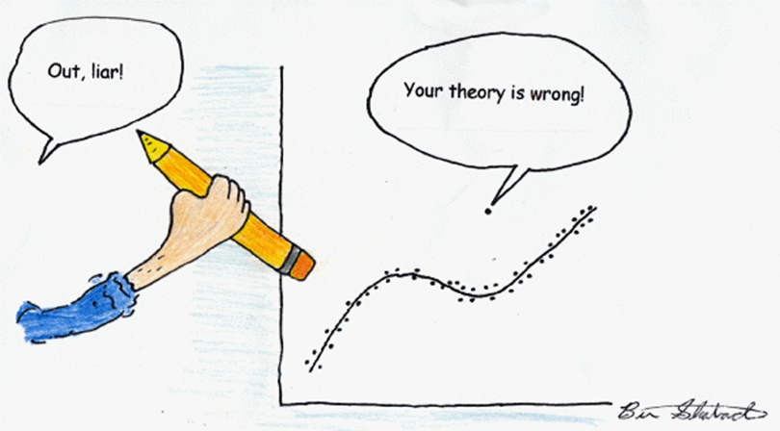
Outliers and Errors
Outliers – values which are far from their expected range
Or having a very low probability of happening (assuming a model)
Many possible cases
Wrong data entry (e.g. an adult weighing 5kg might be 50kg or something else)
Wrong assumptions (the data is correct, our view isn't)
What to do?
Inspect the data point
Try to figure out what happened
If needed, remove the row or try to replace the value
Try a transformation
If possible, perform analysis with and without the outlier(s) and compare your results

Slide 26
Transformations on Features
The quality of our results depends strongly on the features we use
"Garbage in – garbage out"
Dimensionality reduction
Reducing the number of variables (features)
We can do this manually or use algorithms
Feature selection
Selecting only columns that are useful
Feature extraction
Transforming non-structured to structured data
Examples: images, audio, text
Getting meaningful features
Feature engineering
Using our knowledge of the data to create meaningful features
Involves a lot of brainstorming and testing

Slide 27
Next Steps (Optional)
Have a look at scikit-learn's "Dataset Transformations" module
It describes the most common operations
Data cleaning
Dimensionality reduction
Feature extraction
There are many algorithms based on
Data types (e.g. text or numerical data, labelled vs. not labelled)
Model types (how we want to present our data, e.g. linear model)
Algorithm types (e.g. finding similar news articles, recommending movies to users, classifying, etc.)
No "hard and fast rule", use your intuition
Knowing more tools / models / algorithms -> better performance

Slide 28
Summary
Messy and tidy data
Tidying up messy data
Operations on datasets
Cleaning data
Validation
Transformation
Error correction
Features
Data tidying and cleaning as a process

